Slide 1
Earvision Update
08/12/22

Slide 2

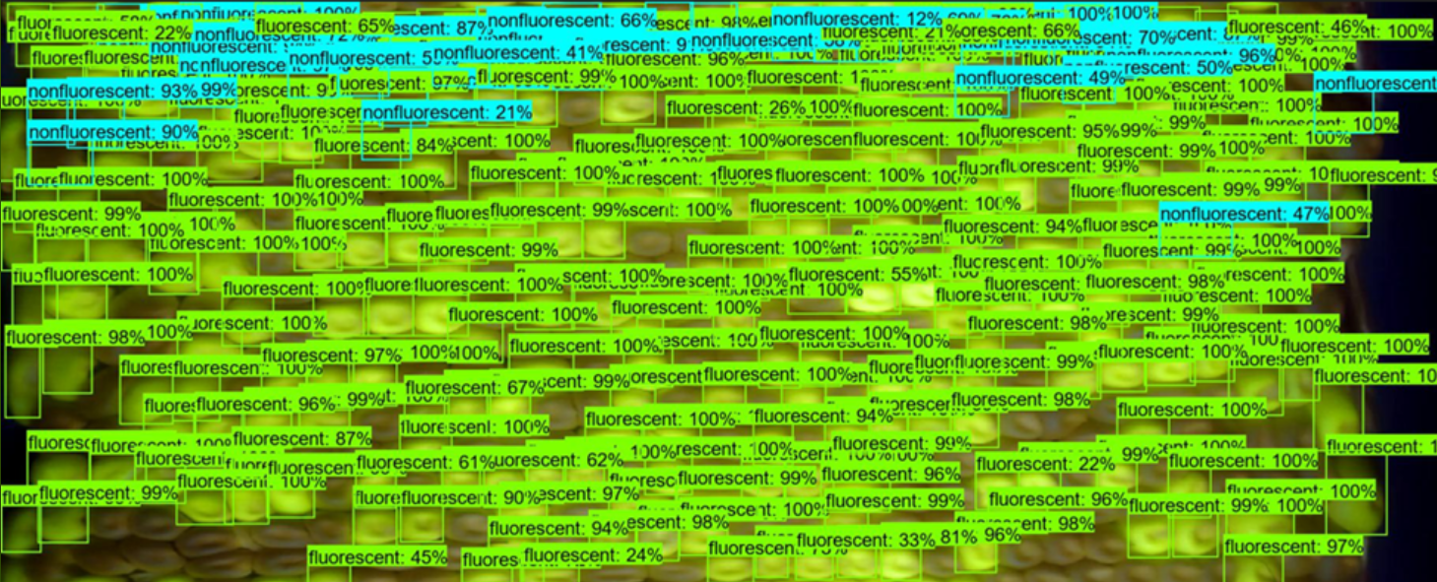

Preliminary Work
Tried getting O.G. EarVision (implemented in Tensorflow) running.
However, could not get it working with GPU. Maybe an issue of it using Tensorflow 1.0 (deprecated).
Was thus slow and also incompletely labeling images:
Decided to re-implement similar system in PyTorch

Slide 3
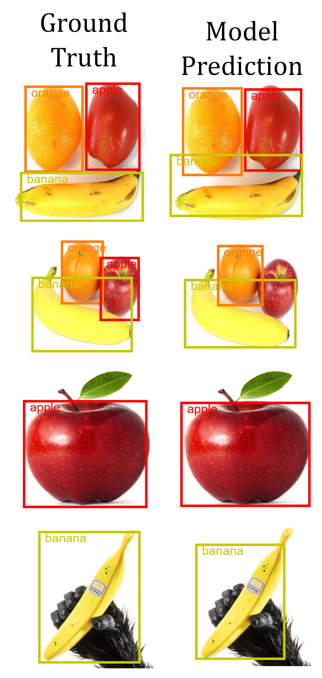
Preliminary Work
Got an object detector working okay on a dataset of fruit pictures
FruitFinder
Uses same model architecture as EarVision 1.0, “Faster R-CNN”

Slide 4
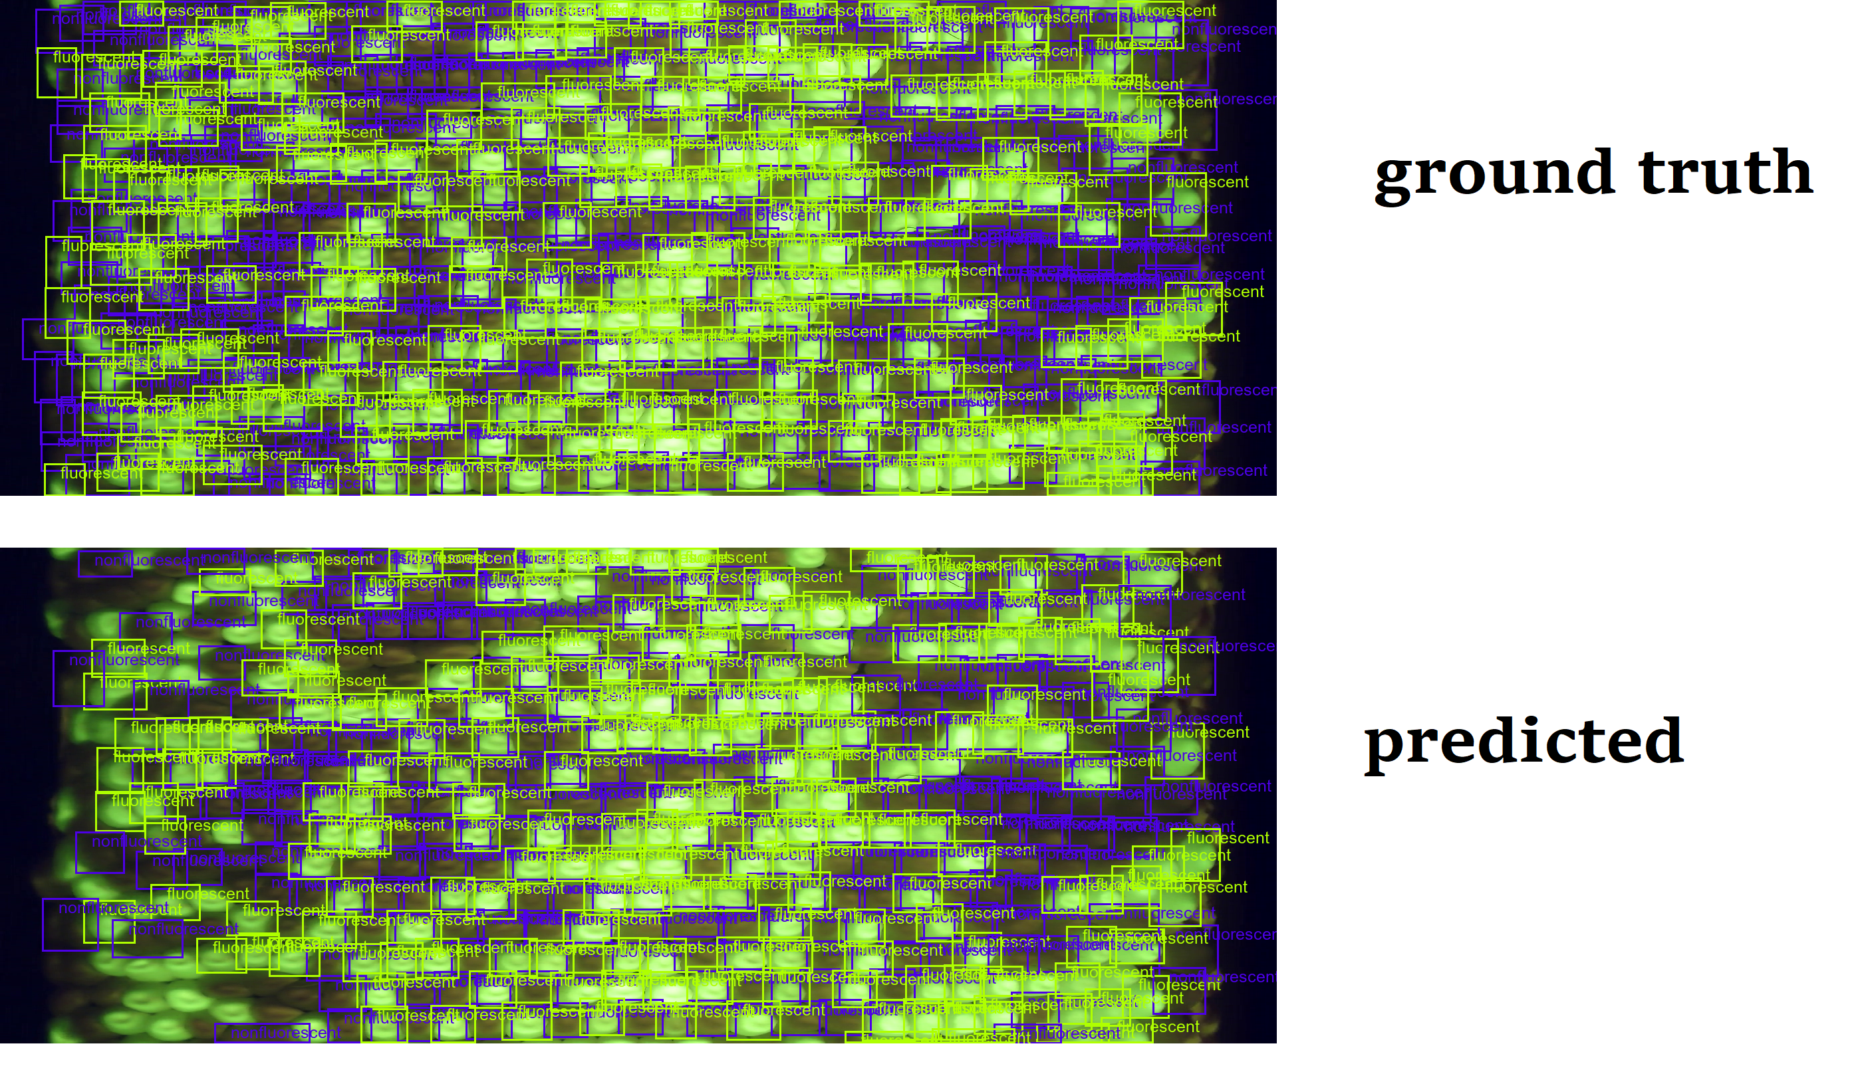
Kernels
Was straightforward to slot in the kernel pictures.
This version of Earvision takes full ear images and does not break them up into 3rds
Results after 5 epochs
Notice it seems to miss entire regions, changing model-specific hyperparameters seemed to help this

Slide 5
Kernels
On the training set of images from 2018/2019, annotated with bounding boxes:
Currently getting around ~4% error on the kernels counts, and between 1-2% error on the transmission rates.
How to calculate transmission rate error?
predicted – actual / actual ?
Or, since it is a percentage already, should we just be looking at how many percentage points off?
For example:
Predicted transmission: 29%
Actual transmission: 26.5%
Would the error be 9.4%?
Or would we say 2.5%?
Unfortunately, don’t have any pics from validation set from this training round

Slide 6
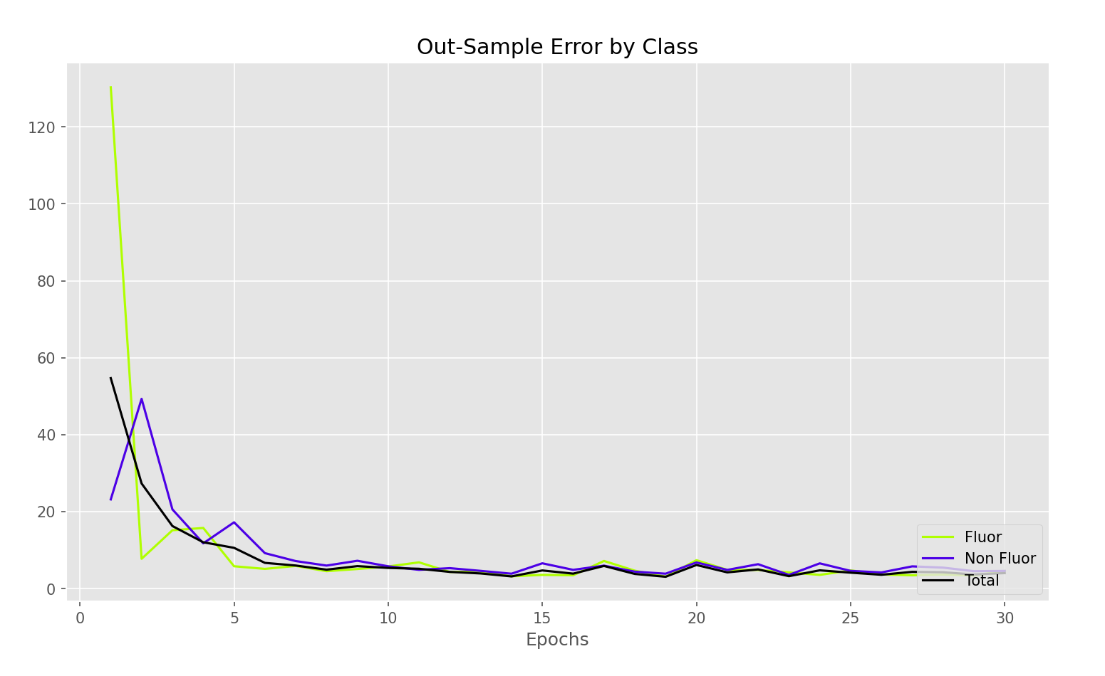
Kernels
Kernel count error
Most of the learning happens within first few epochs
Takes around ~30 min to train 30 epochs.
(due to technicality, takes longer than it should)

Slide 7
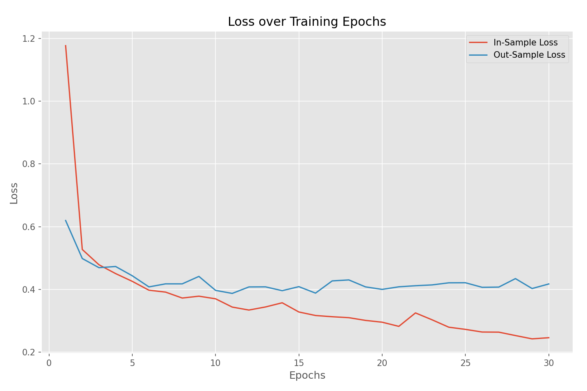
Kernels
Most of the learning happens within first few epochs

Slide 8
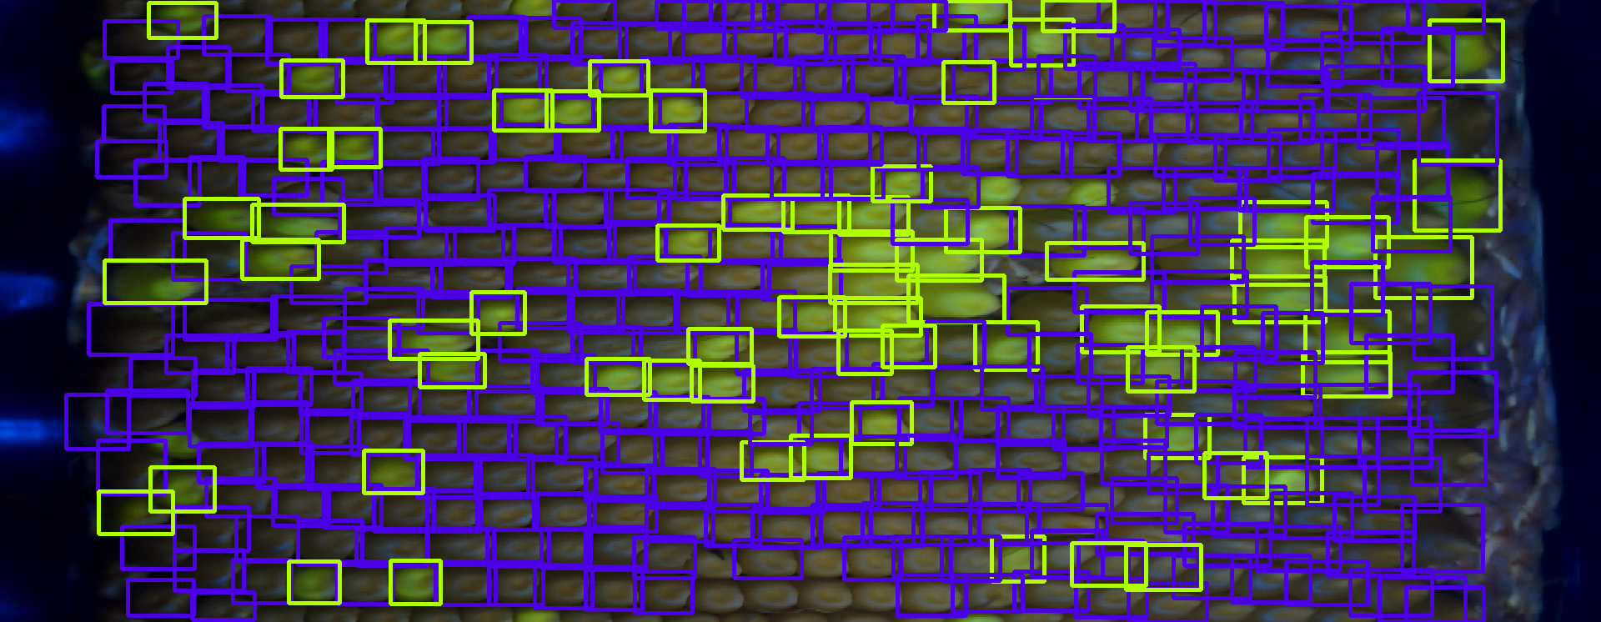
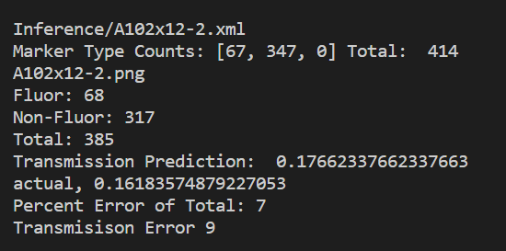
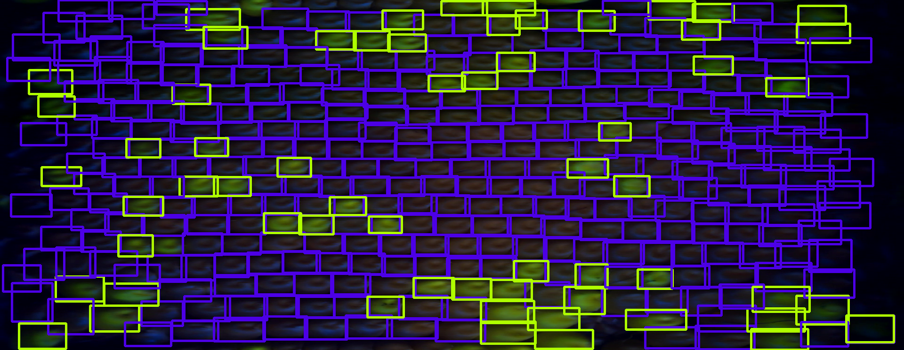
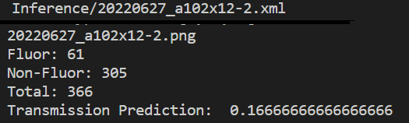
Kernels
A102x12-2
RWLB?
Cordley?

Slide 9
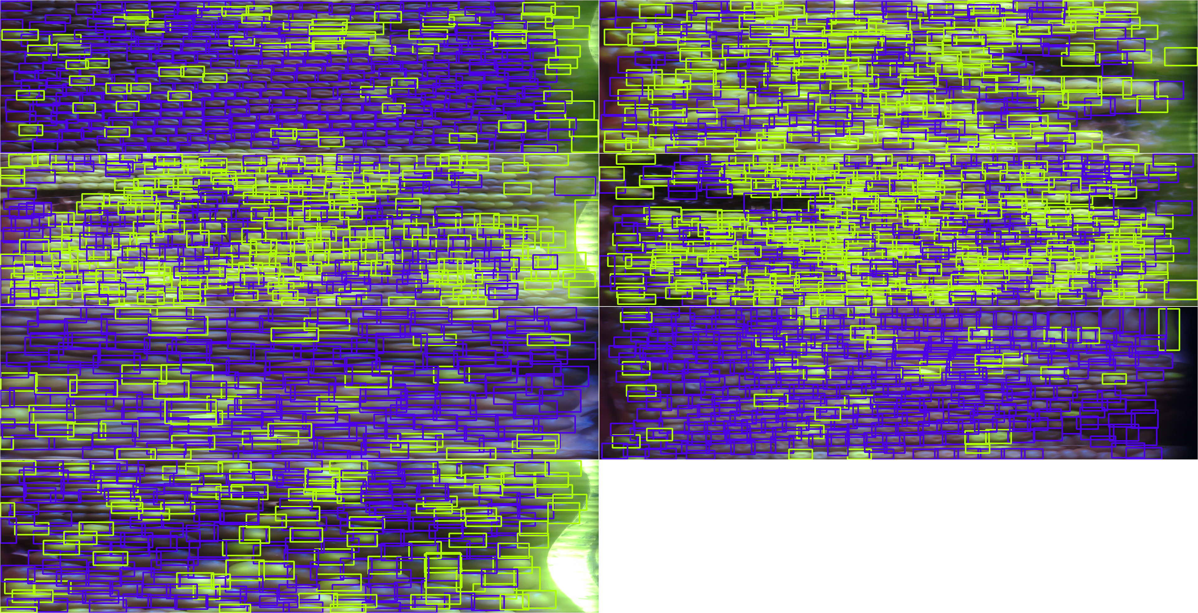
New Cameras:
Turquoise
Image A102x12-2 (top left corner of both montages) Actual: F: 67 NF: 347 Total: 414 Turq prediction: F: 69 NF: 294 Total: 363 Yellow prediction: F:22 NF: 25 Total: 47
Image A12-2x102 (top right corner of both montages) Actual: F: 146 NF: 142 Total: 288 Turq prediction: F: 140 NF: 126 Total: 266 Yellow prediction: F: 59 NF: 27 Total: 86

Slide 10
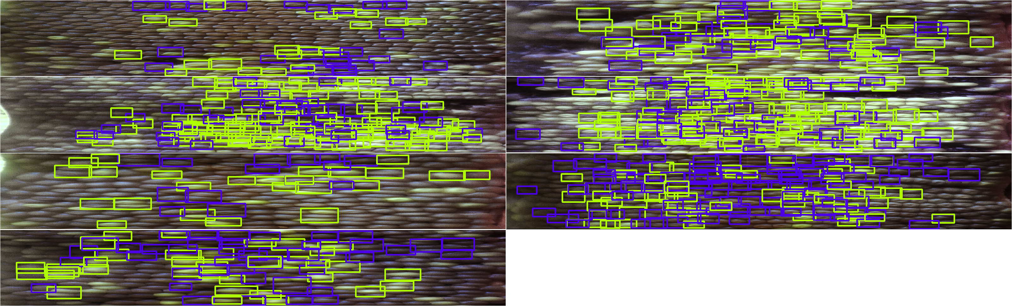
New Cameras:
Yellow
Image A102x12-2 (top left corner of both montages) Actual: F: 67 NF: 347 Total: 414 Turq prediction: F: 69 NF: 294 Total: 363 Yellow prediction: F:22 NF: 25 Total: 47
Image A12-2x102 (top right corner of both montages) Actual: F: 146 NF: 142 Total: 288 Turq prediction: F: 140 NF: 126 Total: 266 Yellow prediction: F: 59 NF: 27 Total: 86

Slide 11
